Slide 1


Cloud Computing and Security
BIS613D
Module 5
Cloud Programming and Software Environments
Department of ISE

Slide 2
Programming on Microsoft Azure

Slide 3
Programming Support in Azure
Key programming components are:
  Client development environment,
  SQLAzure, and
  Rich storage and Programming subsystems
Underlying Azure fabric consists of virtualized hardware together with a sophisticated control environment implementing dynamic assignment of resources and fault tolerance
Implements Domain Name System (DNS) and Monitoring Capabilities

Slide 4
Programming Support in Azure
Automated service management allows service models to be defined by an XML template and multiple service copies to be instantiated on request
Services are monitored and one can access event logs, trace/debug data, performance counters, IIS web server logs, crash dumps, and other log files
No debugging capability for running cloud applications, but debugging is done from a trace

Slide 5
Programming Support in Azure
Basic features are divided into storage and compute capabilities
Azure application is linked to the Internet through a customized compute VM called a web role supporting basic Microsoft web hosting
Configured VMs are often called as appliances
Compute class is the worker role reflecting the importance in cloud computing of a pool of compute resources that are scheduled as needed
The roles support HTTP(S) and TCP

Slide 6
Programming Support in Azure
Roles offer the following methods:
  The OnStart() method which is called by the Fabric on startup, and allows you to perform initialization tasks. It reports a Busy status to the load balancer until you return true.
  The OnStop() method which is called when the role is to be shut down and gives a graceful exit.
  The Run() method which contains the main logic.

Slide 7
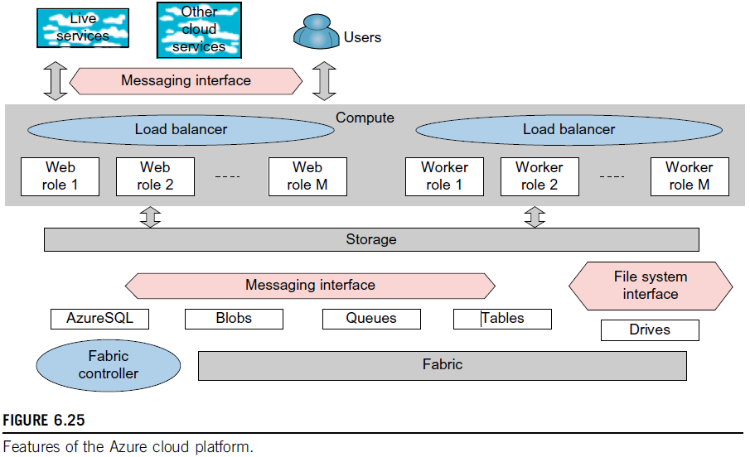
Features of the Azure Cloud Platform

Slide 8
SQL Azure
Azure offers a very rich set of storage capabilities
SQLAzure service offers SQLServer as a service
All the storage modalities are accessed with REST interfaces except for the recently introduced Drives that are analogous to Amazon EBS
Offers a file system interface as a durable NTFS volume backed by blob storage
REST interfaces are automatically associated with URLs and all storage is replicated three times for fault tolerance and is guaranteed to be consistent in access

Slide 9
SQL Azure
Basic storage system is built from blobs (binary large objects) which are analogous to S3 for Amazon
Blobs are arranged as a three-level hierarchy:
      Account → Containers → Page or Block Blobs
Containers are analogous to directories in traditional file systems with the account acting as the root
Block blob is used for streaming data and each such blob is made up as a sequence of blocks of up to 4MB each, while each block has a 64 byte ID
Block blobs can be up to 200GB in size
Page blobs are for random read/write access and consist of an array of pages with a maximum blob size of 1 TB
One can associate metadata with blobs as <name, value> pairs with up to 8 KB per blob

Slide 10
Azure Tables
Azure Table and Queue storage modes are aimed at much smaller data volumes
Queues provide reliable message delivery and are naturally used to support work spooling between web and worker roles
Queues consist of an unlimited number of messages which can be retrieved and processed at least once with an 8 KB limit on message size
Azure supports PUT, GET, and DELETE message operations as well as CREATE and DELETE for queues
Each account can have any number of Azure tables which consist of rows called entities and columns called properties

Slide 11
Azure Tables
There is no limit to the number of entities in a table and the technology is designed to scale well to a large number of entities stored on distributed computers
All entities can have up to 255 general properties which are <name, type, value> triples
Two extra properties, PartitionKey and RowKey, must be defined for each entity.
There are no constraints on the names of properties—this table is very flexible!

Slide 12
Azure Tables
RowKey is designed to give each entity a unique label; while PartitionKey is designed to be shared and entities with the same PartitionKey are stored next to each other
A good use of PartitionKey can speed up search performance
An entity can have, at most, 1 MB storage; if you need large value sizes, just store a link to a blob store in the Table property value
ADO.NET (focuses on low-level data access) and LINQ (Language Integrated Query) support table queries

Slide 13
Recollect Quiz
Key programming components of Azure are _____________________, _____________________ and _______________________
No debugging capability for running cloud applications, but debugging is done from ______________ .
Configured VMs are often called ______________.
SQLAzure service offers ____________________.
____________ are analogous to directories in traditional file systems with the account acting as the root
Azure supports ___________ message operations as well as ___________ for queues.
Notes:
Client development environment, SQLAzure, and Rich storage and Programming subsystems
a trace
Appliances
SQLServer as a service
Containers
PUT, GET, and DELETE message operations as well as CREATE and DELETE for queues

Slide 14
IAT and University Questions
Explain Microsoft Azure’s programming support for cloud applications.
Briefly explain the features of Azure Cloud Platform.
Briefly explain the concepts of SQLAzure and Azure Tables
What are the methods offered by the roles in Microsoft Azure? Briefly explain.
Notes:
Client development environment, SQLAzure, and Rich storage and Programming subsystems
a trace
Appliances
SQLServer as a service
Containers
PUT, GET, and DELETE message operations as well as CREATE and DELETE for queues

Slide 15
THANK YOU

